Slide 1

Chapter 2: Professionalism and responsibility

Slide 2
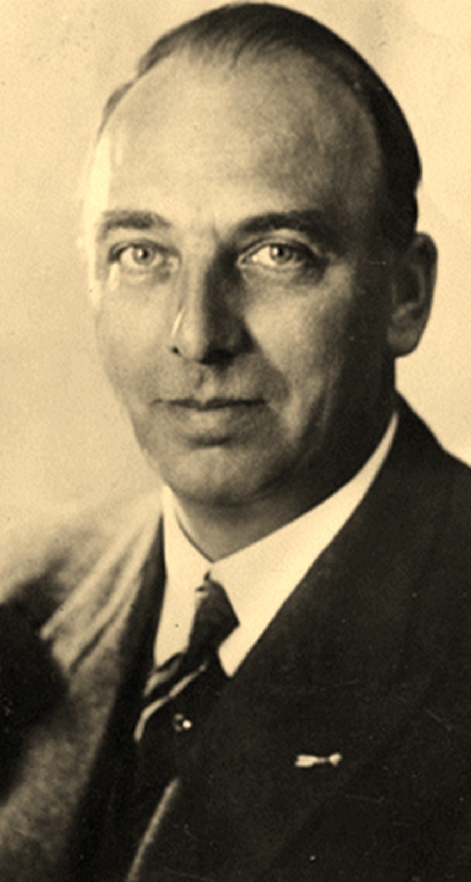
“Theoretically, the collection of data for each person can be so abundant and complete that we can finally speak of a paper human representing the natural human”
-Jacobus Lentz
Notes:
Dude developed ID cards rejected by Dutch as undemocratic, then came the Nazis and loved his work which

Slide 3
Overview
Introduction
How Well Developed are the Computing Professions?
How do Computer-related Careers Stack up?
Ability to Harm the Public
ACM Code of Ethics and Professional Conduct
IEEE Code of Ethics

Slide 4
Introduction
Profession: A vocation that requires a high level of education and practical experience in the field.
Professionals have a special obligation to ensure their actions are for the good of those who depend on them, because their decisions can have more serious consequences.

Slide 5
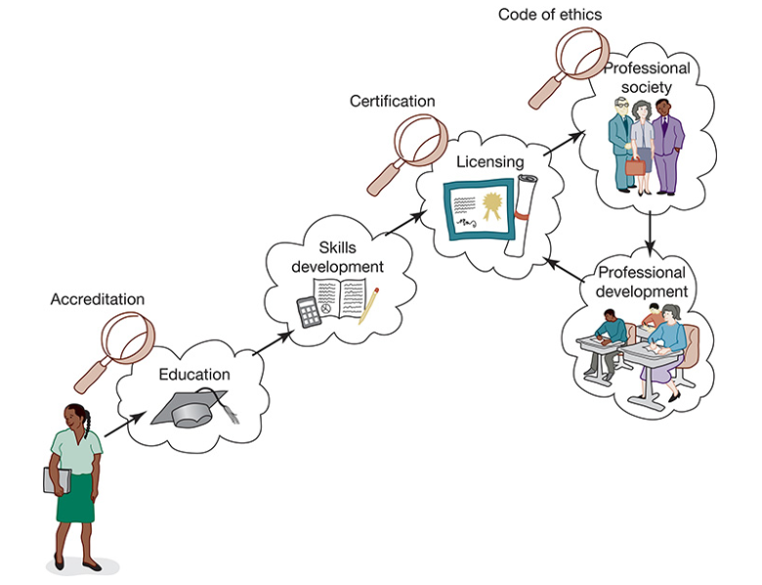

Slide 6
How Well Developed are the Computing Professions?
A fully developed profession has a well-organized infrastructure for certifying new members and supporting those who already belong to the profession.
Ford and Gibbs have identified eight components of a mature professional infrastructure:
Initial Professional Education: formal course work completed by candidates before they begin practicing the profession
Accreditation: A means of assuring that the formal course work meets the standards of the profession
Skills Development: Activities that provide candidates with the opportunity to gain practical skills needed to practice the profession.

Slide 7
How Well Developed are the Computing Professions?
Certification: A process by which candidates are evaluated to determine their readiness to enter the profession.
Licensing: The process giving candidates the legal right to practice the profession
Professional Development: Formal coursework completed by professionals to maintain and develop their knowledge and skills.
Code of Ethics: A mechanism by which a profession ensures that its members use their knowledge and skills for the benefit of society.
Professional Society: An organization promoting the welfare of the profession, typically consisting of most, if not all, members of the profession.

Slide 8
How do Computer-related Careers Stack up?
People may write computer programs and maintain computer systems, either as consultants, sole proprietors, or members of larger firms, without being certified or having been granted a license.
A person does not have to complete college or serve an apprenticeship under the guidance of an experienced mentor in order to gain employment as a programmer, system administrator, or system analyst.
The vast majority of people who hold computer-related jobs do not belong to either of computing’s professional societies.
No professional organization has the authority to forbid someone from managing computer networks or writing computer programs

Slide 9

How do Computer-related Careers Stack up?
Most computer programmers work inside a company as part of a team that includes many other programmers as well as managers.
The responsibility of an individual person is difficult to discern. Low-level decisions are made by groups, and final authority rests with management.

Slide 10

Ability to Harm the Public
The computing “profession” may not be as well developed as the medical or legal professions, but in one key respect – the ability to harm members of the public – those who design, implement, and maintain computer hardware and software systems sometimes hold responsibilities similar to those held by members of mature professions

Slide 11

ACM Code of Ethics and Professional Conduct
Association for Computer Machinery (ACM): Founded in 1947 and considered the world’s largest scientific and educational computing society.
ACM is a non-profit professional membership group that is an umbrella organization for academic and scholarly interests in computer science and informatics.
The ACM adopted a Code of Ethics and Professional Conduct in 2018

Slide 12
ACM Code of Ethics and Professional Conduct
The Code of Ethics and Professional Conducts was designed to inspire and guide the ethical conduct of all computing professionals, including current and aspiring practitioners, instructors, students, influencers, and anyone who uses computer technology in an impactful way.
The code serves as a basis of remediation when violations occur

Slide 13
ACM Code of Ethics and Professional Conduct
The Code of Ethics consists of four sections:
Section 1: General Ethical Principles
Section 2: Professional Responsibility
Section 3: Professional Leadership Principles
Section 4: Compliance With The Code

Slide 14
Section 1: General Ethical Principles
Contribute to society and to human well-being, acknowledging that all people are stakeholders in computing.
Avoid harm
Be honest and trustworthy
Be fair and take action not to discriminate
Respect the work required to produce new ideas, inventions, creative works, and computing artefacts
Respect privacy
Honour confidentiality

Slide 15
Section 2: Professional Responsibilities
Strive to achieve high quality in both the processes and products of professional work
Maintain high standards of professional competence, conduct, and ethical practice
Know and respect existing rules pertaining to professional work
Accept and provide appropriate professional review

Slide 16
Section 2: Professional Responsibilities
Give comprehensive and thorough evaluations of computer systems and their impacts, including analysis of possible risks
Perform work only in areas of competence
Foster public awareness and understanding of computing, related technologies, and the consequences
Access computing and communication resources only when authorized or when compelled by the public good
Design and implement systems that are robustly and usably secure

Slide 17
Section 3: Professional Leadership Principles
Ensure that the public good is the central concern during all professional computing work
Articulate, encourage acceptance of, and evaluate fulfilment of social responsibilities by members of the organisation or group
Manage personnel and resources to enhance the quality of working life

Slide 18
Section 3: Professional Leadership Principles
Articulate, apply, and support policies and processes that reflect the principles of the Code
Create opportunities for members of the organisation or group to grow as professionals
Use care when modifying or retiring systems
Recognise and take special care of systems that become integrated into the infrastructure of society

Slide 19
Section 4: Compliance with the Code
Uphold, promote, and respect the principles of the code
Treat violations of the Code as inconsistent with membership in the ACM

Slide 20
Case Study: Malware Disruption
Rogue Services advertised its web hosting services as “cheap, guaranteed uptime, no matter what.” While some of Rogue’s clients were independent web-based retailers, the majority were focused on malware and spam. Several botnets used Rogue’s reliability guarantees to protect their command-and-control servers from take-down attempts. Spam and other fraudulent services leveraged Rogue for continuous delivery. Corrupted advertisements are often linked to code hosted on Rogue to exploit browser vulnerabilities to infect machines with ransomware.
Despite repeated requests from major ISPs and international organizations, Rogue refused to intervene with these services, citing their “no matter what” pledge to their customers. Furthermore, international pressure from other governments failed to induce national-level intervention, as Rogue was based in a country whose laws did not adequately proscribe such hosting activities.
Ultimately, Rogue was forcibly taken offline through a coordinated effort from multiple security vendors working with several government organizations. This effort consisted of a targeted worm that spread through Rogue’s network. This denial-of-service attack successfully took Rogue’s machines offline, destroying much of the data stored with the ISP in the process. All of Rogue’s clients were affected. No other ISPs reported any impact from the worm, as it included mechanisms to limit its spread. As a result of this action, spam and botnet traffic immediately dropped significantly. In addition, new infections of several forms of ransomware ceased.

Slide 21
Analysis: Malware Disruption
Rogue violated the code by facilitating harm caused by their clients
1.1 Contribute to society and to human well-being, acknowledging that all people are stakeholders in computing
1.2 Avoid harm
Rogue was aware that their machines were used for unauthorized access to computing resources, in addition to not taking into account the public good, therefore violating:
2.8 Access computing and communication resources only when authorized or when compelled by the public good
3.1 Ensure that the public good is the central concern during all professional computing work

Slide 22
Analysis: Malware Disruption
From the worm authors’ perspective, they violated:
1.2 Avoid Harm: The harm in this case is ethically justified, and they took steps to minimize the harm.
However, Rogue’s retailer clients lost their data, meaning that the worm authors needed to provide a better solution that limited the unintentional harm
They adhered to the code in:
1.1 Contribute to society and to human well-being, acknowledging that all people are stakeholders in computing
2.8 Access computing and communication resources only when authorized or when compelled by the public good.

Slide 23

IEEE Code of Ethics
The Institute of Electrical and Electronics Engineers (IEEE), founded in 1963, was the result of the merger between two organizations, the American Institute of Electrical Engineers (AIEE) founded in 1884, and the Institute of Radio Engineers (IRE), founded in 1912.
Considered the world’s largest technical professional organization, IEEE’s membership encompasses computer scientists, software developers, IT professionals, physicists, medical doctors, and electrical and electronics engineers.

Slide 24
IEEE Code of Ethics
The first version was adopted in 1974 and went through several iterations until its current version was adopted by the IEEE Board of Directors in June 2020.
It consists of 3 articles and 10 guidelines:
To uphold the highest standards of integrity, responsible behaviour, and ethical conduct in professional activities
To treat all persons fairly and with respect, to avoid harassment or discrimination, and to avoid injuring others.
To strive to ensure this code is upheld by colleagues and co-workers

Slide 25
IEEE Code of Ethics: Article 1
To hold paramount the safety, health, and welfare of the public, to strive to comply with ethical design and sustainable development practices, to protect the privacy of others, and to disclose promptly factors that might endanger the public or the environment
To improve the understanding by individuals and society of the capabilities and societal implications of conventional and emerging technologies, including intelligent systems
To avoid real or perceived conflicts of interest whenever possible, and to disclose them to affected parties when they do exist

Slide 26
IEEE Code of Ethics: Article 1
To avoid unlawful conduct in professional activities, and to reject bribery in all its forms
To seek, accept, and offer honest criticism of technical work, to acknowledge and correct errors, to be honest, and realistic in stating claims or estimates based on available data, and to credit properly the contributions of others
To maintain and improve our technical competence and to undertake technological tasks from others only if qualified by training or experience, or after full disclosure of pertinent limitations

Slide 27
IEEE Code of Ethics: Article 2
To treat all persons fairly and with respect, and not to engage in discrimination based on characteristics such as race, religion, gender, disability, age, national origin, etc.
To not engage in harassment of any kind, including sexual harassment or bullying behaviour
To avoid injuring others, their property, reputation, or employment by false or malicious actions, rumours, or any other verbal or physical abuses.

Slide 28
IEEE Code of Ethics: Article 3
To support colleagues and co-workers in following this code of ethics, to strive to ensure the code is upheld, and to not retaliate against individuals reporting a violation.

Slide 29
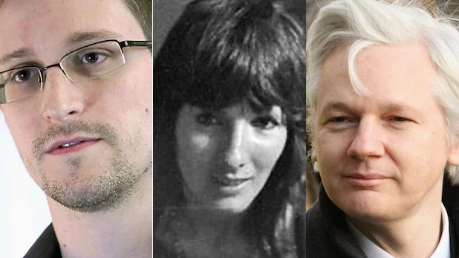
Notes:
Edward Snowden, Julian Assange, and Karen Silkwood

Slide 30
Whistle-blowing
Whistle-blower: Someone who breaks ranks with an organization in order to make an unauthorized disclosure of information about a harmful situation after attempts to report concerns through authorized organizational channels have been ignored or rebuffed.
Sometimes employees become whistle-blowers out of fear that actions taken by their employer may harm the public
Other times, they have identified fraudulent use of public funds/ resources

Slide 31
Morality of Whistle-blowing
We can evaluate the morality of whistle-blowing by considering whether the whistle-blower is motivated by a desire to help others or harm others.
There are three general reactions to altruistic whistle-blowing:
Whistle-blowers cause harm
Whistle-blowing is a sign of Organizational Failure
Whistle-blowing as a moral duty

Slide 32
Whistle-blowers Cause Harm
The typical corporate response in condemnation
Whistle-blowers are disloyal to their companies
Generate bad publicity
Disrupt the social fabric of the organization and sows mistrust

Slide 33
Whistle-blowing is a Sign of Organizational Failure
The organization suffers for bad publicity
Accused managers’ careers can be ruined
Sows mistrust and erodes team spirit
Whistle-blowers typically suffer retaliation and become estranged from their co-workers
Long-term prospects with the company are dim
Organizations need to create management structures and communication processes that allow concerns to be raised, discussed, and resolved

Slide 34
Whistle-blowing as a Moral Duty
Richard De George believes whistle-blowers should ask themselves five questions:
Do you believe the problem may result in “serious and considerable harm to the public”?
Have you told your manager your concerns about the potential harm?
Have you tried every possible channel within the organization to resolve the problem?
Have you documented evidence that would persuade a neutral outsider that your view is correct?
Are you reasonably sure that if you do bring this matter to public attention, something can be done to prevent the anticipated harm?
According to De George, you have a right to whistle-blow if you answer yes to the first three questions, and a duty to whistle-blow if you answer yes to all five questions

Slide 35
Moral Responsibility
People must bear moral responsibility
We cannot assign moral responsibility to a corporation or any other organization
Role Responsibility: responsibility borne because of a person’s assigned duties.
Causal responsibility: Responsibility assigned to people because they did something (or failed to do something) that caused something to happen.
Legal responsibility: responsibility assigned by law.
Moral Responsibility is not exclusive. Example: Parents are responsible for the baby’s well-being

Slide 36
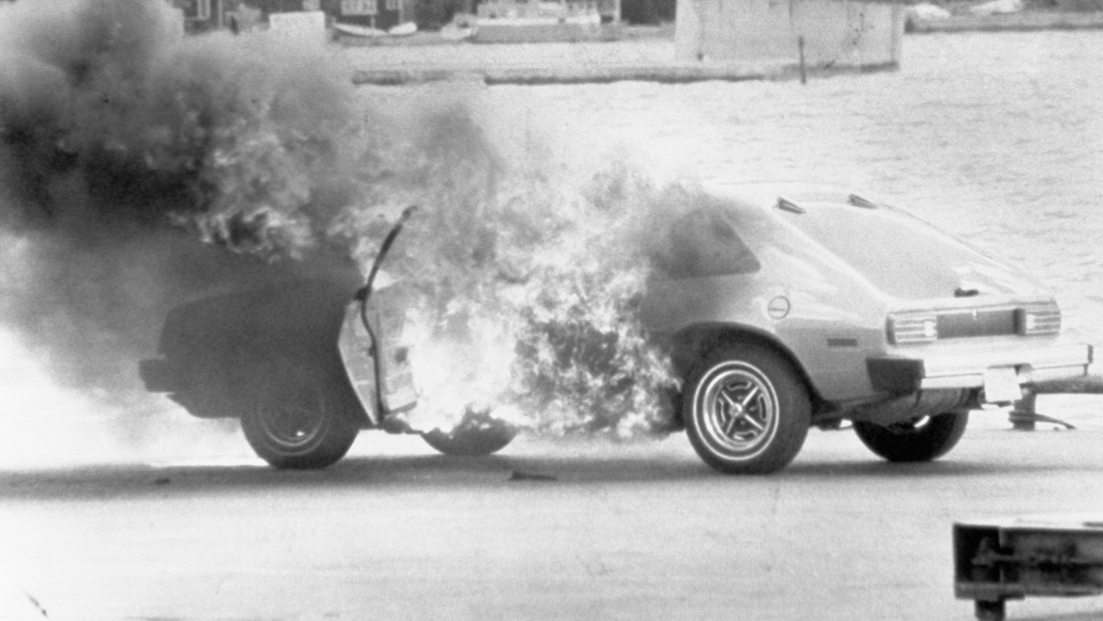
Notes:
Ford Pinto case: In the 70s, executives at Ford wanted to sell a 2,000 pound, $2,000 alternative to Japanese imports. Unfortunately the prototypes did not pass mandatory collision tests, because the windshield keeps popping out. Forbidden from making design changes, the engineers redirected the energy of the collision down the drive train causing gas explosions

Slide 37
Summary
Computing is not a fully mature profession, yet has a high capacity to harm the public.
Ethical guidance is provided through ACM and IEEE Codes of Ethics.
Whistleblowing may be a right or duty under specific moral conditions.
Responsibility is shared: role-based, causal, legal, and moral.
Critical Reflection
Should computing require licensing like medicine or law?
Is loyalty to an employer weaker than duty to society?

